Slide 1
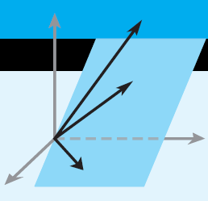
Change of Basis
Chapter # 03 & 04: “Elementary Linear Algebra” by Howard Anton & Chris Rorres

Slide 2
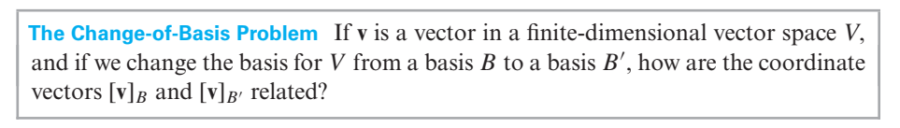
The Change-of-Basis Problem
A basis that is suitable for one problem may not be suitable for another, so it is a common process in the study of vector spaces to change from one basis to another.
Because a basis is the vector space generalization of a coordinate system, changing bases is akin to changing coordinate axes in R2 and R3.
A vector space V is said to be finite-dimensional if there is a finite set of vectors in V that spans V and is said to be infinite-dimensional if no such set exists.

Slide 3
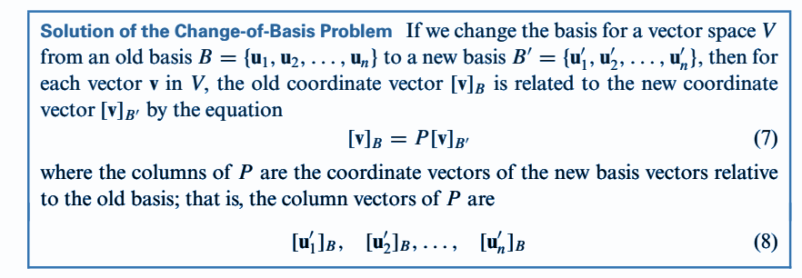

Slide 5
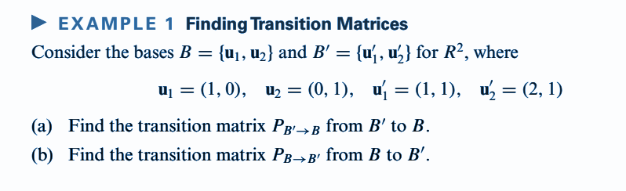
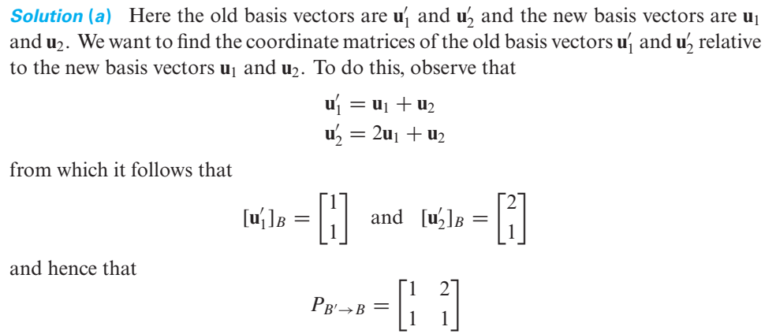

Slide 6
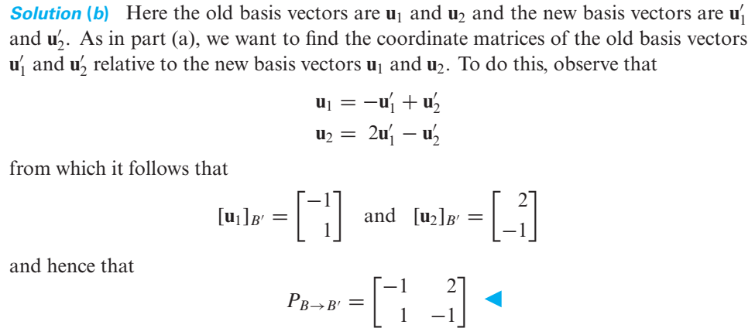

Slide 7
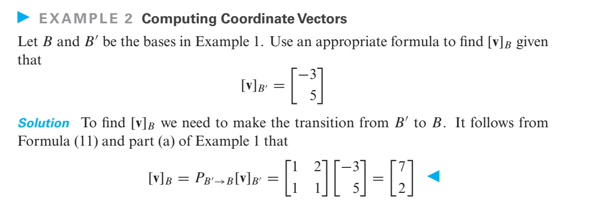

Slide 8
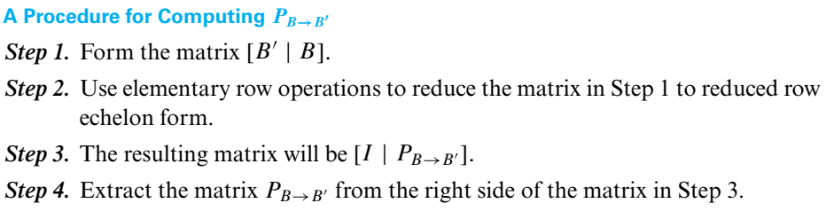
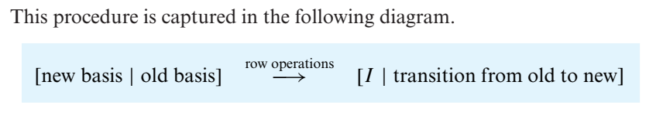
An Efficient Method for Computing Transition Matrices for R^{n}.

Slide 9
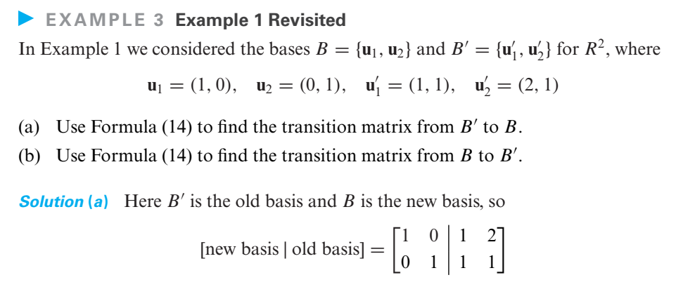
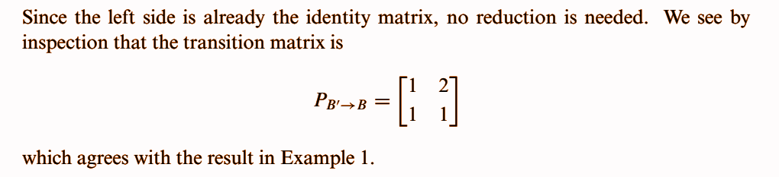

Slide 10
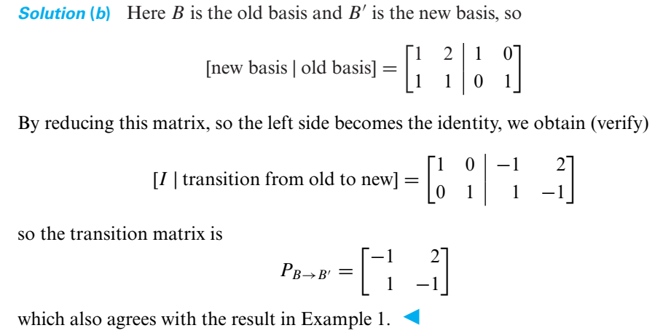

Slide 11
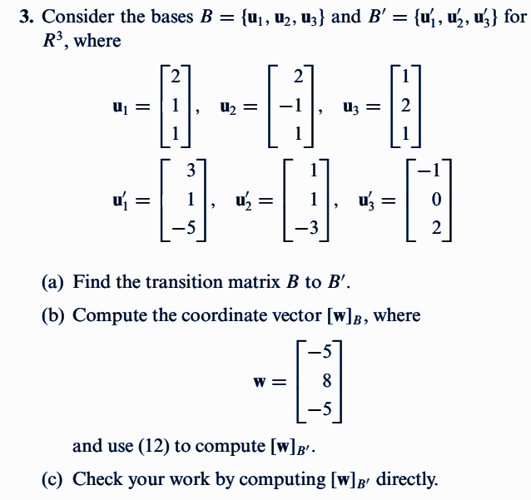

Slide 12
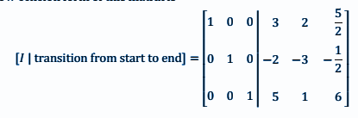
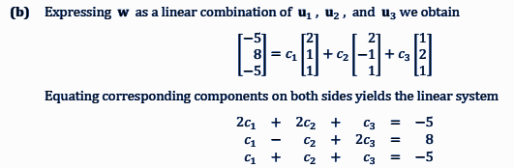


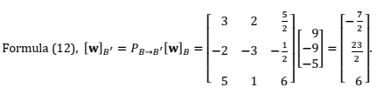

Slide 13
